Slide 1
Backend with Javascript as C# Developer
Using NestJS

Slide 2
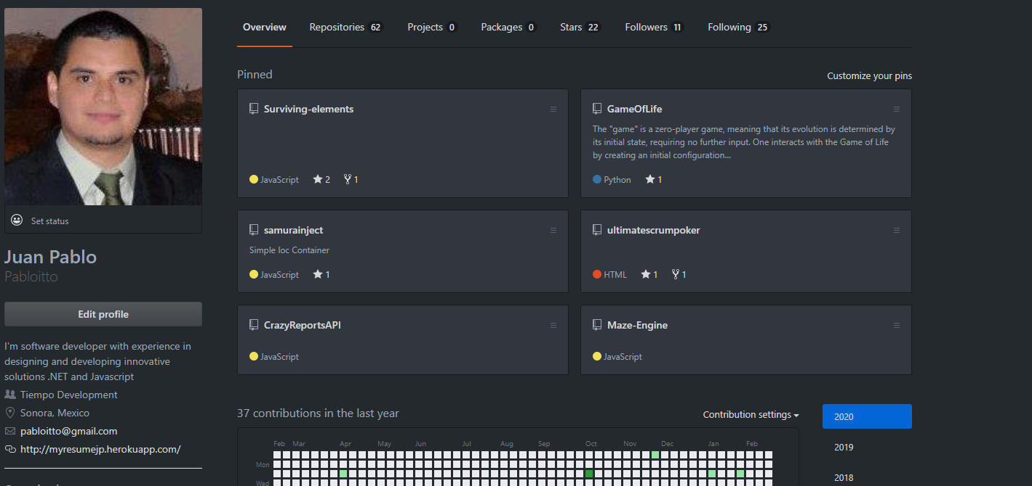
Who Am I

Slide 3
Nest JS ?
Created by Kamil Myśliwiec, Nest JS is a server-side/backend framework shaped to support a developer’s productivity.
Nest framework is a structured, scalable Node application.
It was built to eliminate disorganized codebases.
Heavily inspired by Angular, Nest.js was built with TypeScript and uses Express.js under the hood
Nest JS is a superset of node as Typescript is a superset of javascript

Slide 4
Why?
Nest provides an out-of-the-box application architecture which allows developers and teams to create highly testable, scalable, loosely coupled, and easily maintainable applications.
Nest uses the upfront & the latest version of TypeScript. Typescript ensures that it can change to the JavaScript and eases the context switching.

Slide 5
Features & Design structure
Controllers
Services
Providers
Modules
Dependency Injection
Pipes

Slide 6
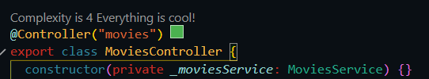
Controllers
Controllers are responsible for handling incoming requests and returning responses to the client.

Slide 7

Services
The service layer methods itself then implement the application logic and make calls to the databases or models.

Slide 8
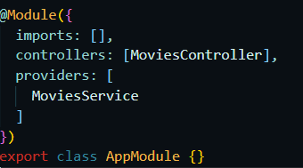
Providers
Providers are a fundamental concept in Nest. Many of the basic Nest classes may be treated as a provider – services, repositories, factories, helpers, and so on.

Slide 9
Modules
A module is a class annotated with a @Module() decorator. The @Module() decorator provides metadata that Nest makes use of to organize the application structure.

Slide 10

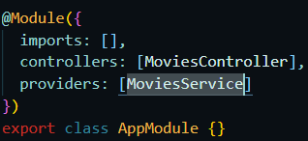
Dependency Injection
Nest is built around the strong design pattern commonly known as Dependency injection

Slide 11

Pipes
Pipes have two typical use cases:
transformation: transform input data to the desired output
validation: evaluate input data and if valid, simply pass it through unchanged; otherwise, throw an exception when the data is incorrect

Slide 12
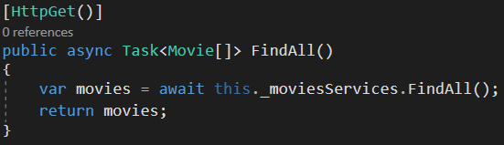
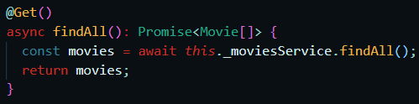
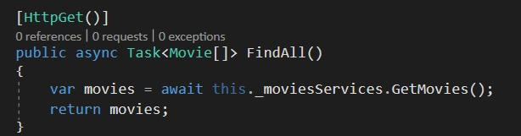
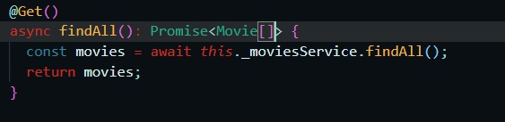
Comparison with C# Endpoint

Slide 13
DEMO TIME

Slide 14
Other Features
Guards
Interceptors
Exception Filters
Swagger
WebSockets
GraphQL
Nest CLI
TypeOrm

Slide 15
Thank You!
Juan Pablo Itto
@pablo_itto
https://github.com/Pabloitto

